Slide 1
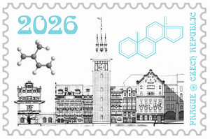
26th Isoprenoid Conference
September 15 - 17, 2026
Prague 1,
Novotného lávka 200/5,
Czech Republic

Slide 2
Traditional meeting on the natural products that from historical reasons bears the name Isoprenoid Conference is to be held at the complex of buildings on the Vltava riverbank, where is the Czech Chemical Society located, together with tens of other societies.
1908

Slide 3
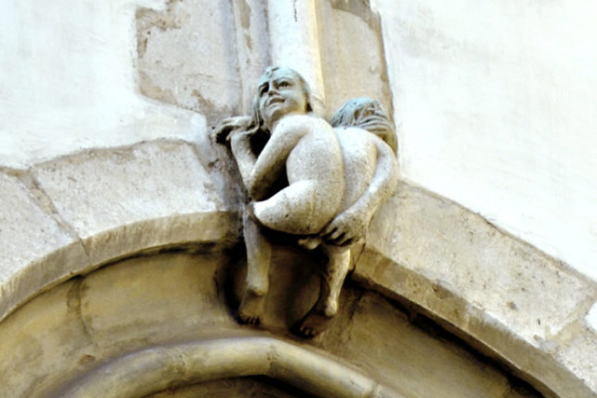
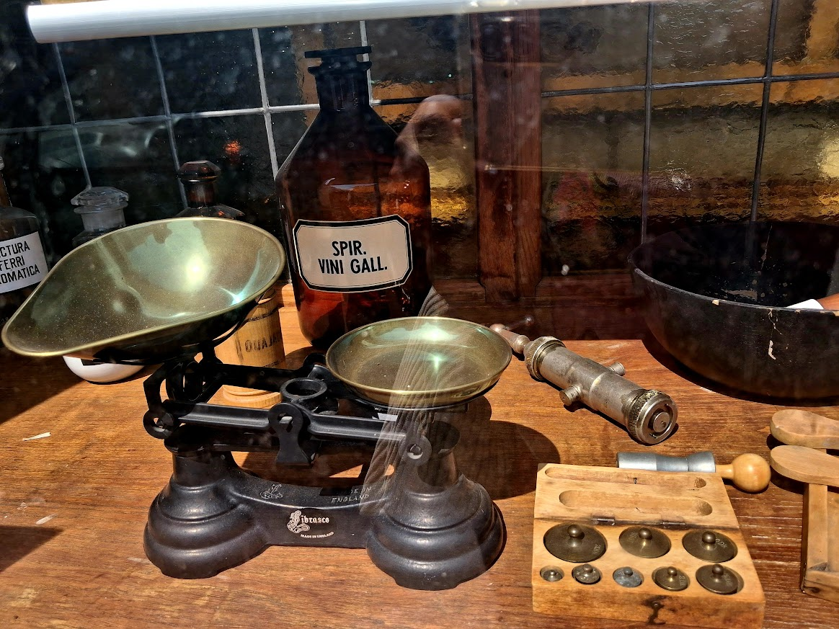
Prague is an old city with many historical peculiarities, monuments and long history of alchemy and folk medicine lore.

Slide 4
26th Isoprenoid Conference
plans to invite, as plenary lectures
Wicha Jerzy, Prof. dr hab. (POL)
Appendino Giovanni Battista, Prof. PhD. (IT)
Marjan Kocór - František Šorm forum, 60 years of Isoprenoid Conference
Kotora Martin, Prof. Ph.D. (CZE)
Synthesis of ent-estrone, ferrocenestrone, side chain modification in brassinosteroids
and on estrone modification as a route to bioactive compounds
Guo De-an, Prof. Ph.D. (CHN)
Chinese Materia Medica by contemporary chemistry
Inoue Masayuki, Prof. Ph.D. (JPN)
Total synthesis and functional analysis of biologically active natural products
Moore Bradley S., Prof. Ph.D. (USA)
Terpenes biosynthesis
i.a.

Slide 5


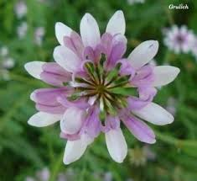
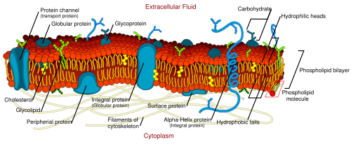
26th Isoprenoid Conference
Plans to open i.a. several topics as:
Synthesis and isolation;
Biosynthesis;
Bioactivity;
Research methodologies;
Industrial and practical applications

Slide 6

Prague is a home of a good hearty
food, prime beer, and hospitality.
Vepřo-knedlo-zelo

Slide 7

We are looking forward to seeing you in Prague on September 15-17, 2026.
All info at
https://isopsoc.org/
https://isopsoc.org/Isoprenoids2026.html

